Slide 1
FIELD STUDY AND ANALYTICAL ASSESSMENT OF SEALED ATTICS CONDUCTED FOR THE STATE OF FLORIDA
Tallahassee, FL 32399-2100
24February
2016
David O. Prevatt, PhD, P.E.
Associate Professor
University of Florida, Gainesville, FL
William Miller, Ph.D., P.E.
Research Scientist Oak Ridge National Laboratory
Joint Faculty at the University of Tennessee
Mechanical Engineering
Architecture and Design

Slide 2
TOPICS COVERED
Project Team
Motivation
Purpose & Goals
Scope of Work
Milestones and Deliverables
Field Instrumentation
SCHOOL OF SUSTAINABLE INFRASTRUCTURE & ENVIRONMENT
FIELD STUDY AND ANALYTICAL ASSESSMENT OF SEALED ATTICS CONDUCTED FOR THE STATE OF FLORIDA
SPONSOR: Florida Building Commission

Slide 3
Project team
University of Florida – Dr. David O. Prevatt
Associate Professor
Dept. of Civil and Coastal Engineering
Oak Ridge National Laboratory (Subcontract):
- Dr. WA Miller, Building Envelope Program
- Dr. S. Pallin
- P. Boudreaux
- Dr. R. Jackson
- A. Desjarlais

Slide 4
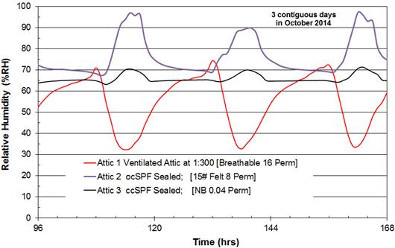
Motivation
ORNL Observed Peaks in RH in Sealed Attics
Visual Evidence of Moisture Storage in ocSPF

Slide 5
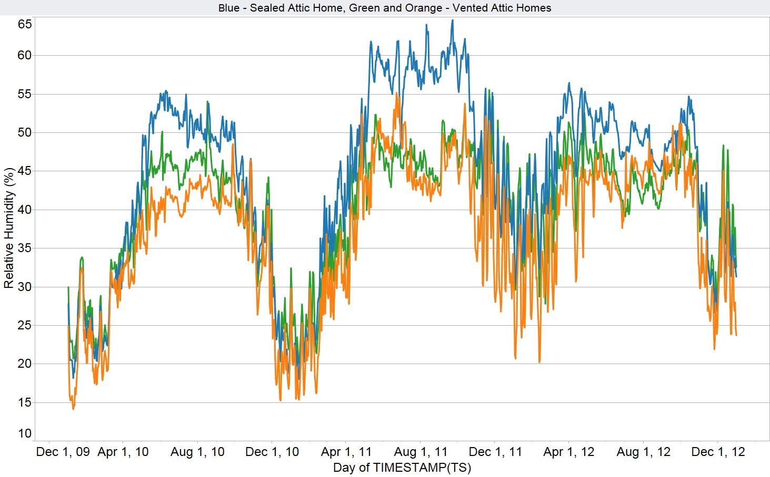
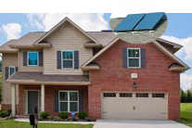
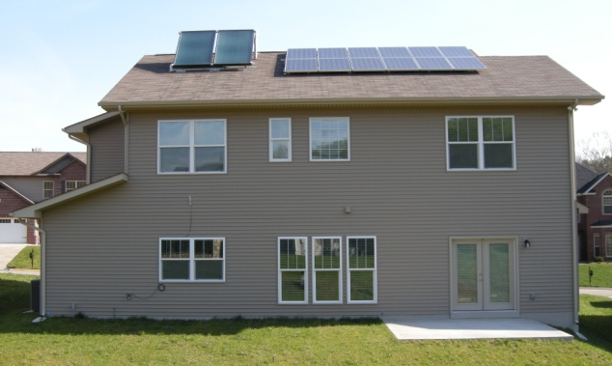
The Effect of Sealed/Unvented Attics on Indoor Comfort and Roof Assembly Durability

Slide 6
Purpose & goal
PURPOSE
To monitor relative humidity, temperature and moisture content of sheathing in two residential structures having sealed attic systems.
To document the air tightness of the homes, duct systems and sealed attics.
GOALS
To record the moisture content of the wood roof decks and relative humidity & temperature of the indoor ambient, the outdoor ambient and the attic for a 12 month period that includes the hot and humid summer months.

Slide 7
OBJECTIVES
Two residential structures will be set up across Florida to acquire field data.
Field data will be used to assess the potential of moisture retention in the foam insulation, which can lead to structural damage to the sheathing.

Slide 8
SCOPE OF WORK
Two houses to be identified in ASHRAE climatological zones 1 and 2.
Conduct homeowner’s survey to document experience with sealed attics.
Conduct blower door and duct blaster tests to determine air exchange rate.
Install mini-data logger in attic to acquire data wirelessly.

Slide 9
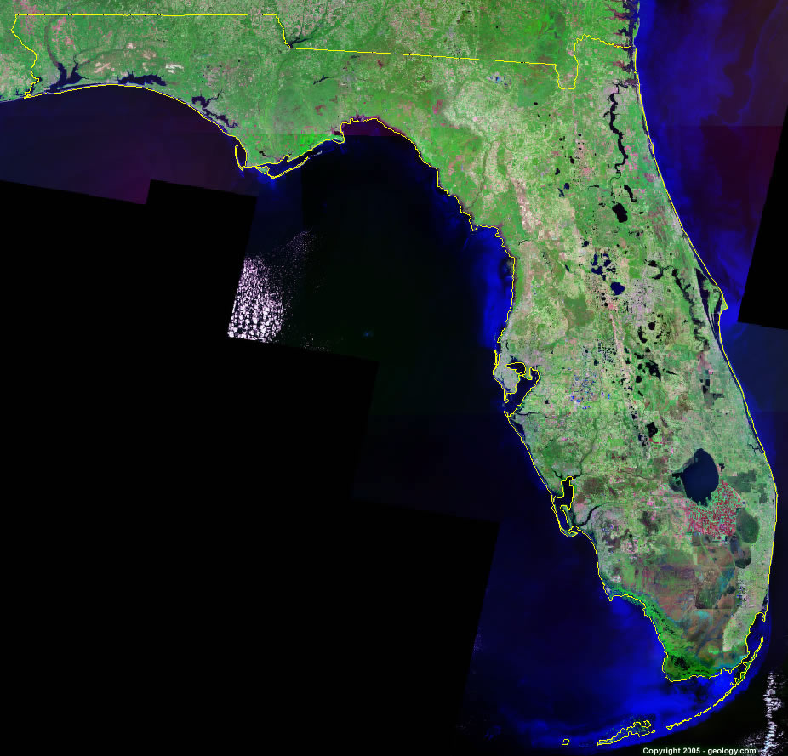
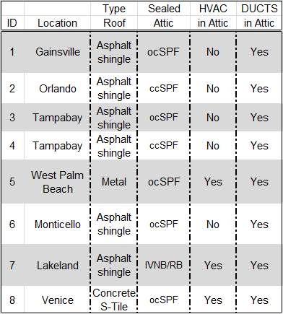
Project Status
6
1
2
3,4
7
8
5

Slide 10
Field instrumentation
Roof cross section showing the spray foam insulation with RH, temperature and moisture pins installed in the wood sheathing.

Slide 11
Field instrumentation
Campbell Scientific Data Logger CR6
Data acquisition system
This instrument is used to collect data
such as temperature and moisture
Content.
Minneapolis Duct Blaster System
This instrument is used to determine the air leakage in the duct system of a house.

Slide 12
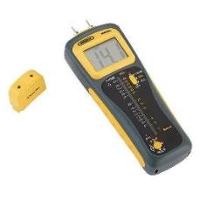
FIELD INSTRUMENTATION
Moisture Pins
Delmhorst Meter
Blower Door Test is used to determine the air leakage through doors, windows and other openings.
Moisture pins (nails) are used to determine the moisture content in the wood sheathing.

Slide 13
Codal provisions
The Florida Building Code 2010 provides the following information
2304.11.4.2 WOOD STRUCTURAL MEMBERS
Wood structural members that support moisture-permeable floors or roofs that are exposed to weather, such as concrete or masonry slabs, shall be of naturally durable or preservative-treated wood unless separated from such floors or roofs by impervious moisture barrier.
2603.4.1.6 Foam Plastics in Attics and crawlspaces
Within an attic or crawlspace, foam plastic insulation shall be protected against ignition by 1.5in thick mineral fiber insulation, 0.25in wood structural panel or other approved material installed in such a manner that the foam insulation is not exposed.

Slide 14
OUTCOME
A Go/no Go decision for analytical study and benchmarks will be made based on the results of the field study.
The Go decision will allow the ORNL computer toolkit to compare analytical models against empirical findings of moisture accumulation.

